Slide 1




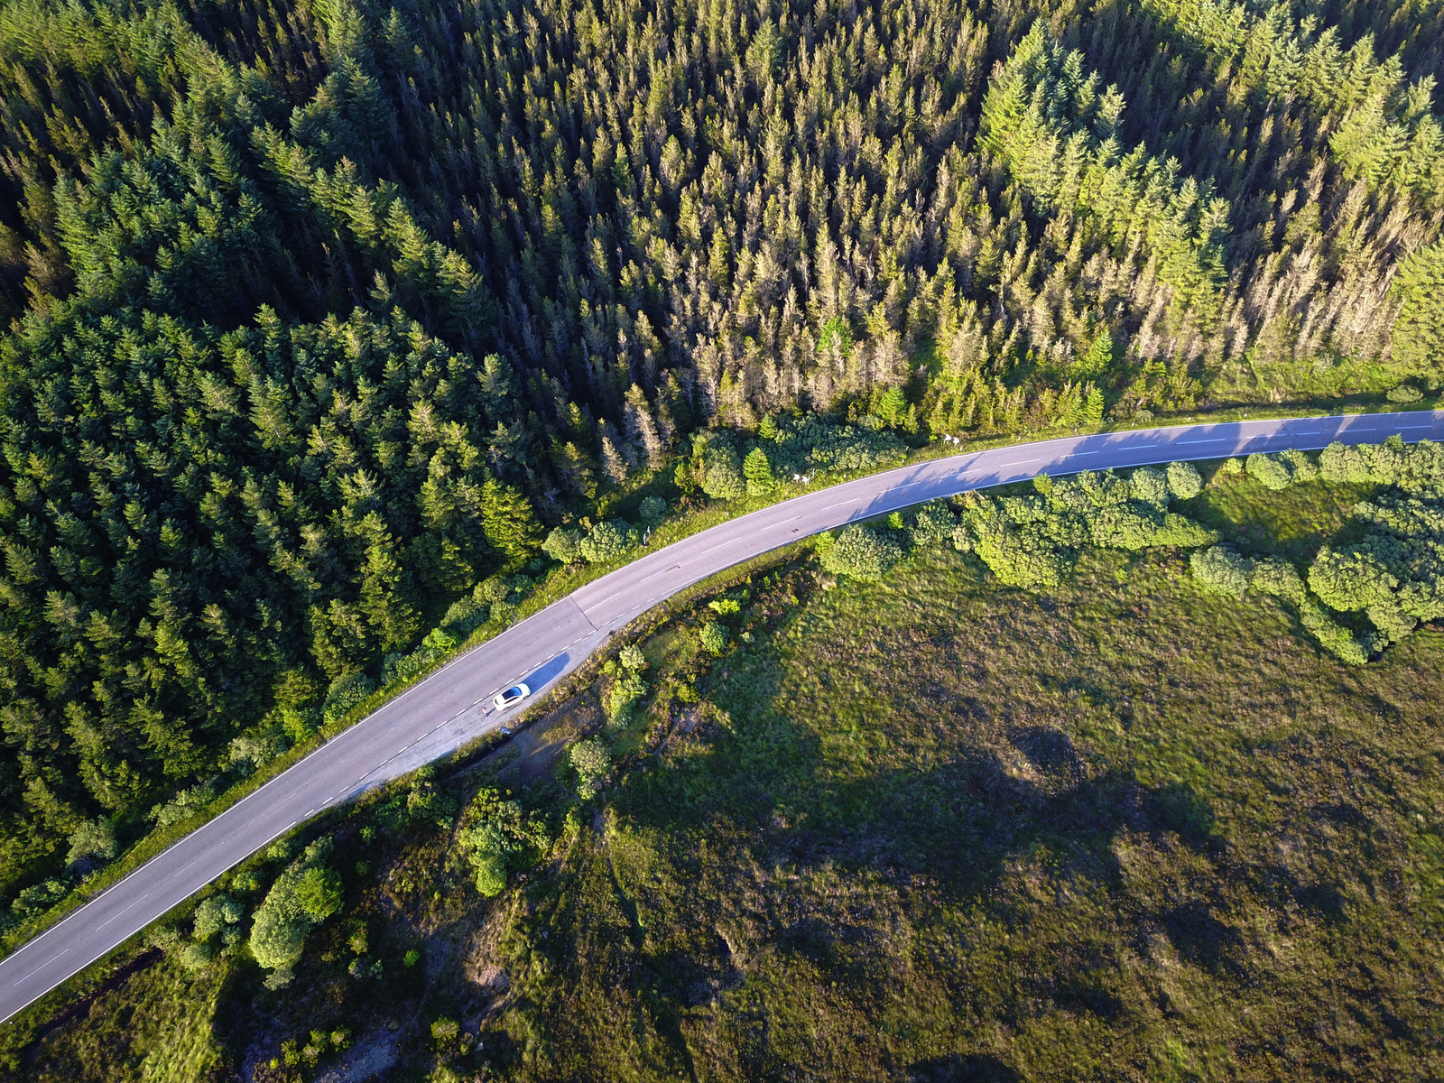

Traffic System
DSA
PROJECT
Application of
Circular Queue

Slide 2

Traffic System
Anus
Shaikh
Niraj Pujari
Project Team
Muskaan
Shaikh
Mukti Shah
Upendra
Saw
Akshay Nair

Slide 3
Traffic System
What is Circular Queue?

Slide 4
Traffic System
Implementations of Circular Queue

Slide 5
Traffic System
Code

Slide 6


Reference
Traffic System
Pygame
https://www.pygame.org/
Python
https://docs.python.org/3/library/time.html
https://docs.python.org/3/library/random.html

Slide 7

Traffic System
Thank you!
Welcome!

